Slide 1

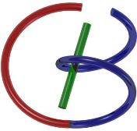
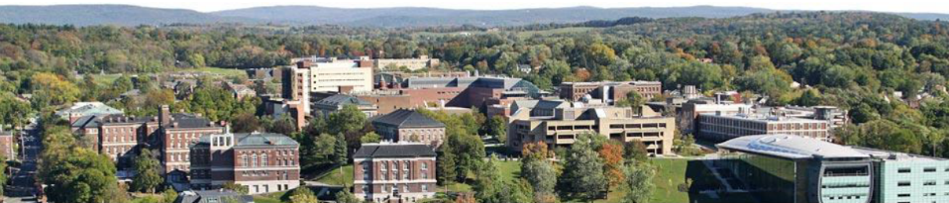
38655 BMED-2300-02
Lecture 21: Ultrasound Imaging
Ge Wang, PhD
Biomedical Imaging Center
CBIS/BME, RPI
wangg6@rpi.edu
April 17, 2018

Slide 2
BB Schedule for S18
Tue | Topic | Fri | Topic
1/16 | Introduction | 1/19 | MatLab I (Basics)
1/23 | System | 1/26 | Convolution
1/30 | Fourier Series | 2/02 | Fourier Transform
2/06 | Signal Processing | 2/09 | Discrete FT & FFT
2/13 | MatLab II (Homework) | 2/16 | Network
2/20 | No Class | 2/23 | Exam I
2/27 | Quality & Performance | 3/02 | X-ray & Radiography
3/06 | CT Reconstruction | 3/09 | CT Scanner
3/20 | MatLab III (CT) | 3/23 | Nuclear Physics
3/27 | PET & SPECT | 3/30 | MRI I
4/03 | Exam II | 4/06 | MRI II
4/10 | MRI III | 4/13 | Ultrasound I
4/17 | Ultrasound II | 4/20 | Optical Imaging
4/24 | Machine Learning | 4/27 | Exam III
Office Hour: Ge Tue & Fri 3-4 @ CBIS 3209 | wangg6@rpi.edu
Kathleen Mon 4-5 & Thurs 4-5 @ JEC 7045 | chens18@rpi.edu

Slide 3
Ultrasound Imaging Methods
Imaging Modes
A-, M-, B, C-Mode Scan
Huygens' Principle
Array-based Scanning & Beam Forming
Doppler Imaging
Doppler Frequency
Continuous Wave & Pulsed Mode
Echo Correlation & Color Doppler
Image Artifacts
New Things

Slide 4
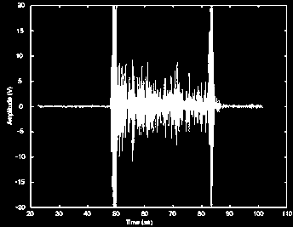
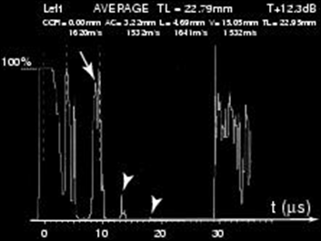
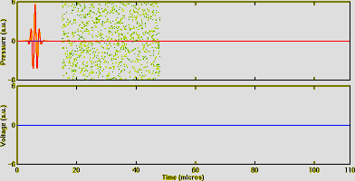
US Imaging Modes
A mode (A = amplitude)
2 x distance = c x time
c for the different tissues

Slide 5
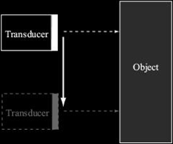
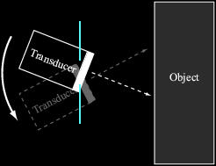
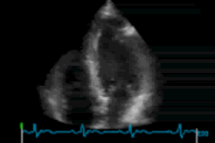
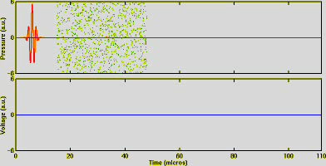
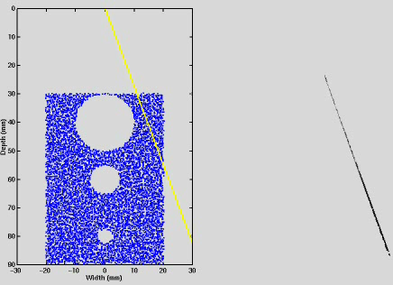
B mode (B = brightness)

Slide 6
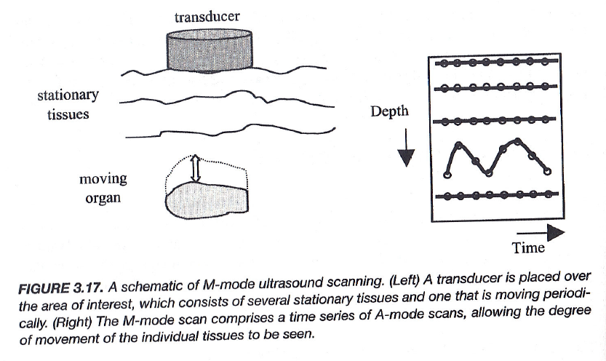
M-Mode

Slide 7
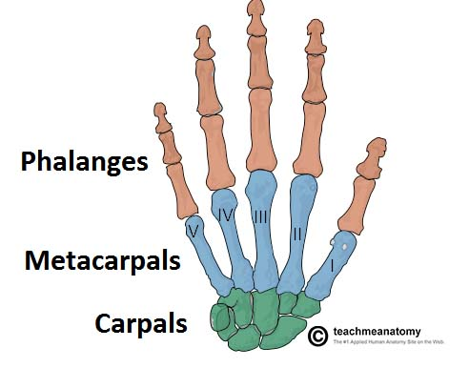
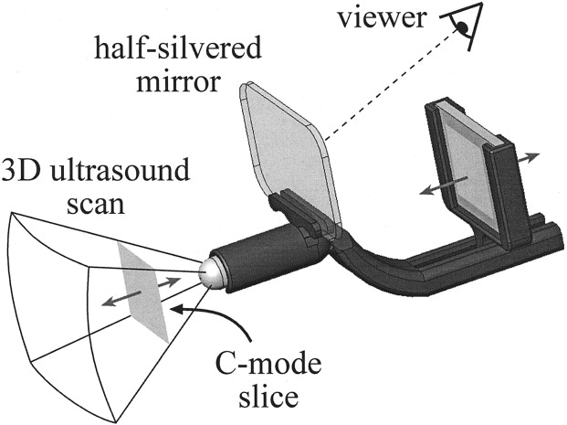
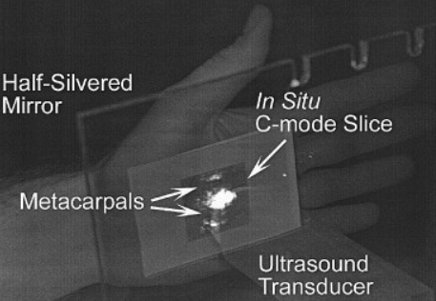
C-Mode
C-mode imaging produces a coronal image by gating A-mode data to a specific depth. A half-silvered mirror can be used to merge the body surface with his/her interior without a head-mounted display.
https://www.sciencedirect.com/science/article/pii/S1076633205001121

Slide 8
Types of US Arrays

Slide 9
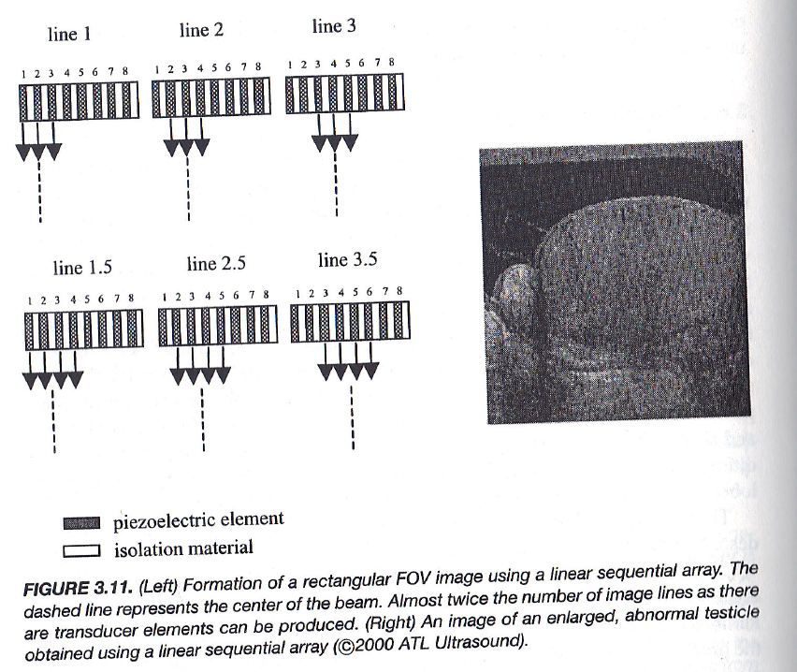
Linear Sequential Array

Slide 10
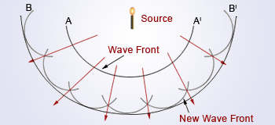
Huygens' Principle
Any current point on a wave front is a new source, and all such new “secondary sources” collectively determine a future wave front.

Slide 11
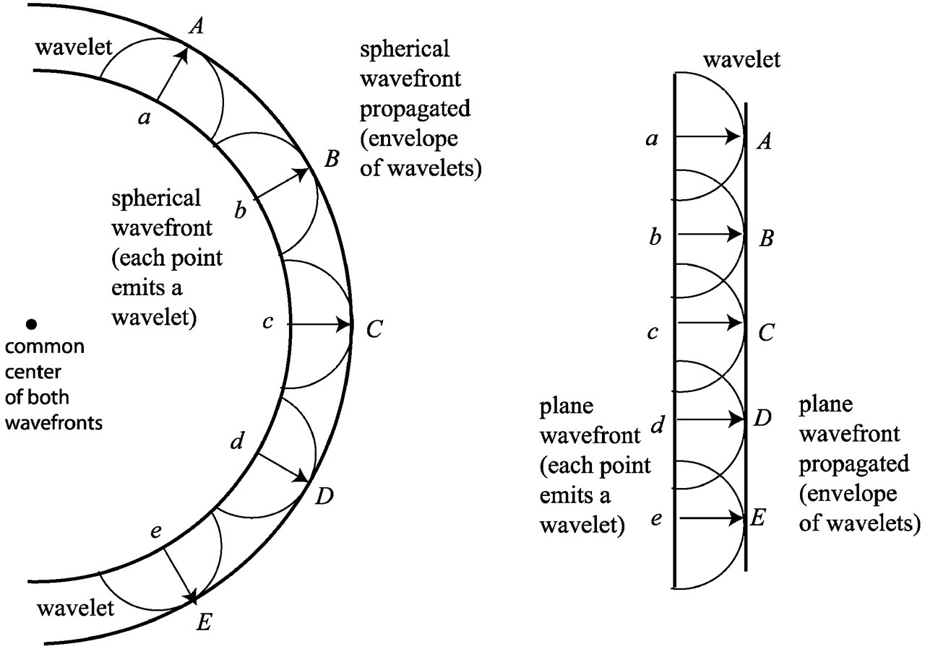
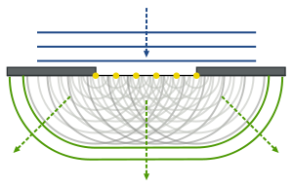
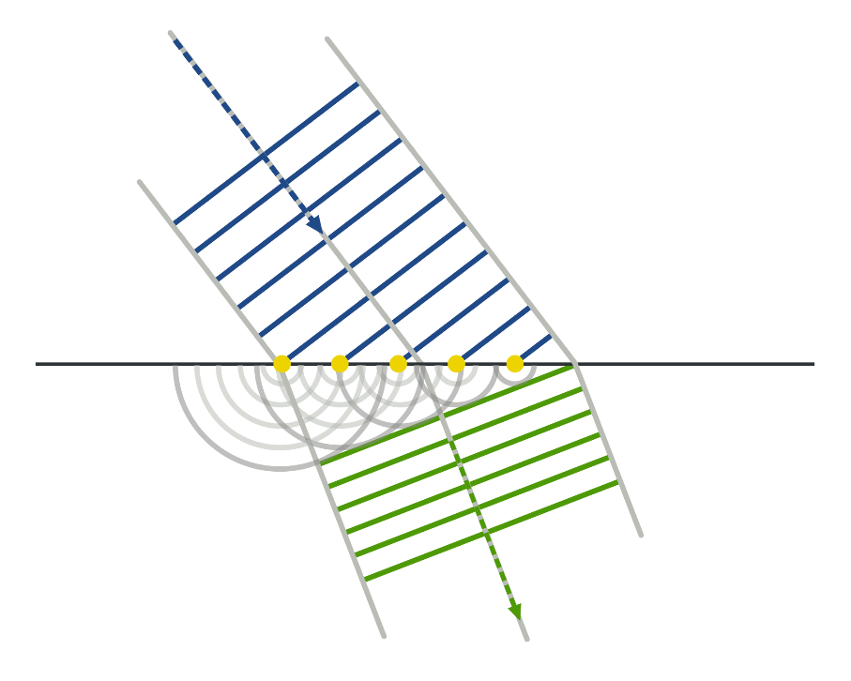
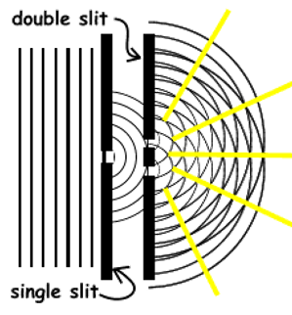
Examples

Slide 12
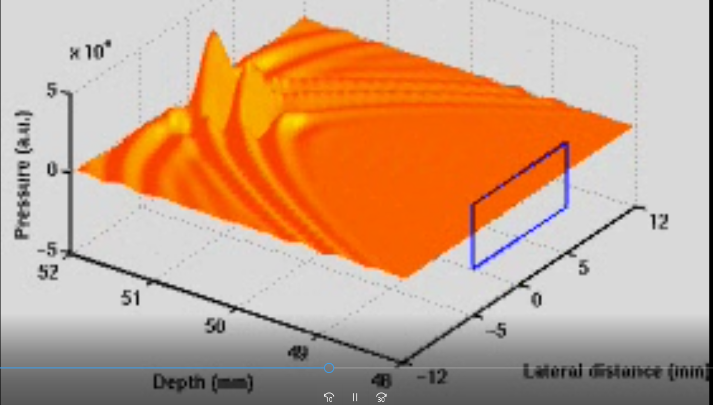
Transducer Array as Wave Front
2D Array

Slide 13
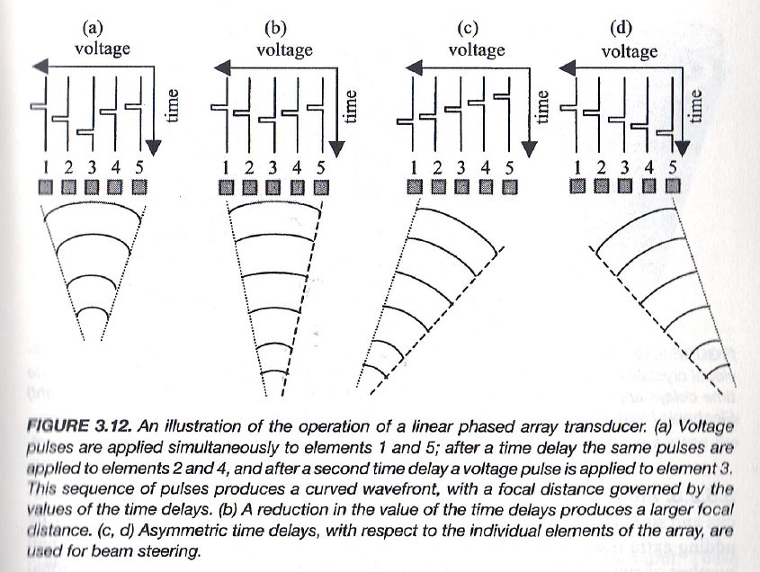
Linear Phased Array
https://www.youtube.com/watch?v=zGpoi-Y65JM

Slide 14
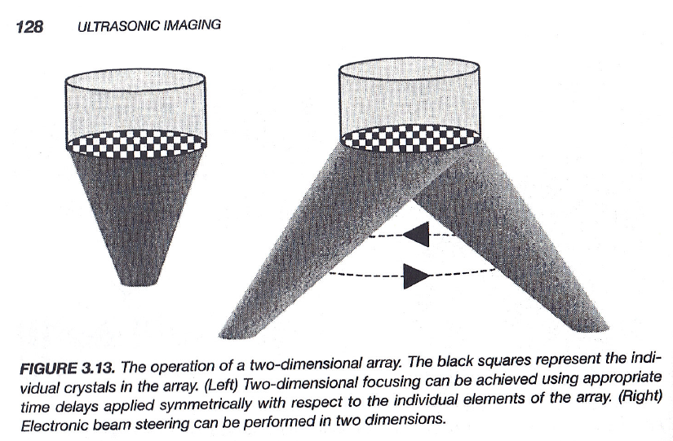
2D Phased Array

Slide 15
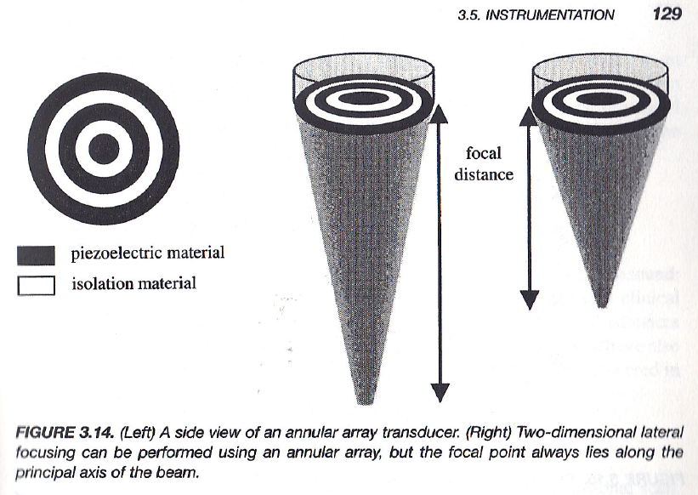
Annular Array

Slide 16
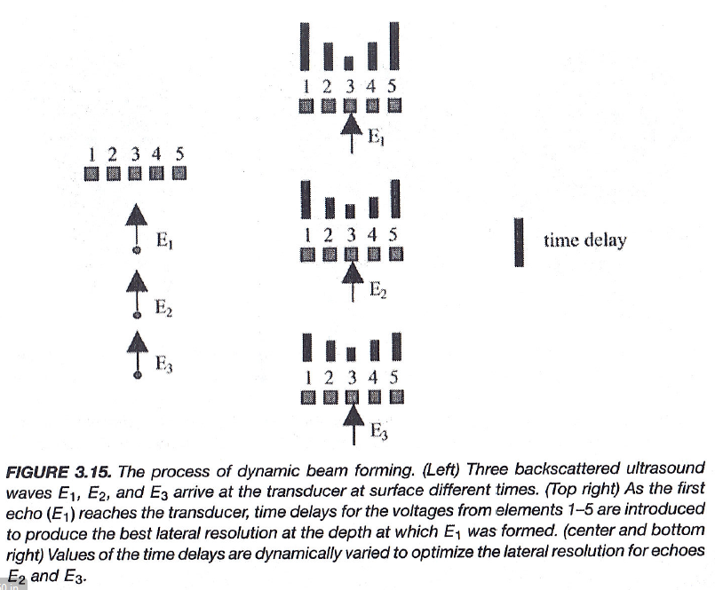
Beam Forming

Slide 17
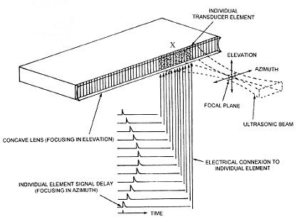
Beam Forming & Scanning
http://www.ob-ultrasound.net/lineararrays.html

Slide 18
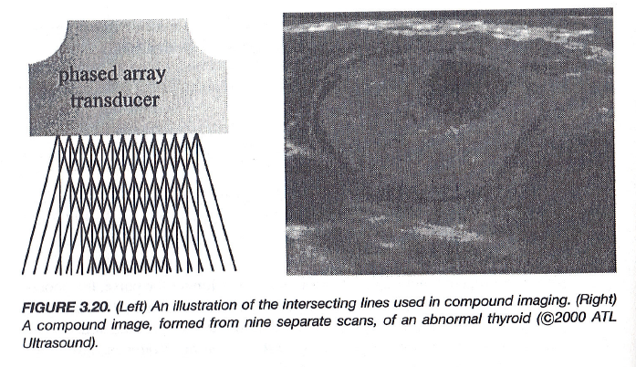
Compound Imaging

Slide 19
Ultrasound Imaging Methods
Imaging Modes
A-, M-, B, C-Mode Scan
Huygens' Principle
Array-based Scanning & Beam Forming
Doppler Imaging
Doppler Frequency
Continuous Wave & Pulsed Mode
Echo Correlation & Color Doppler
Image Artifacts
New Things

Slide 20
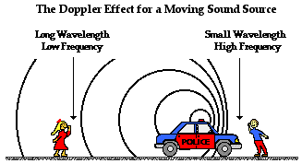

Slide 21
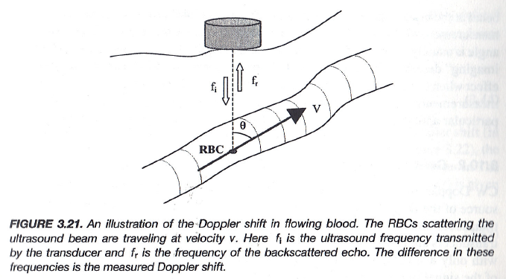
Doppler Shift in Your Book

Slide 22
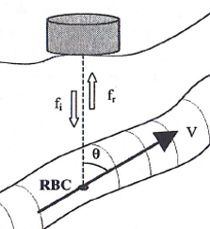
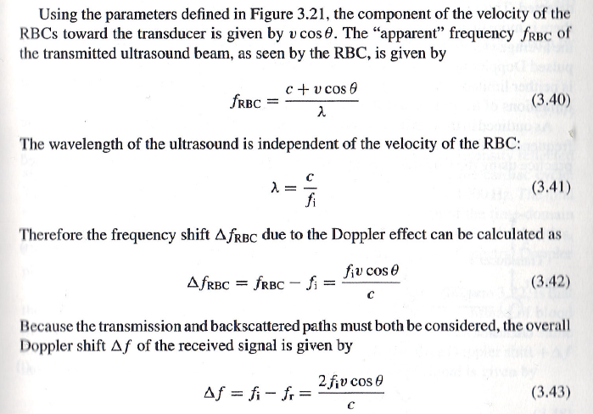
Doppler Shift

Slide 23
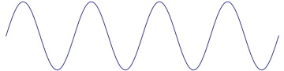
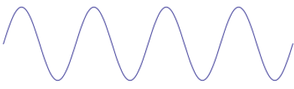
Why?
Stationary
Transducer
Object
c
Speed c = Frequency*Wavelength
In a unit time, 4 pulse into the object
Moving
Transducer
Object
c
c
Speed c = Frequency*Wavelength
In a unit time, 8 pulse into the object

Slide 24
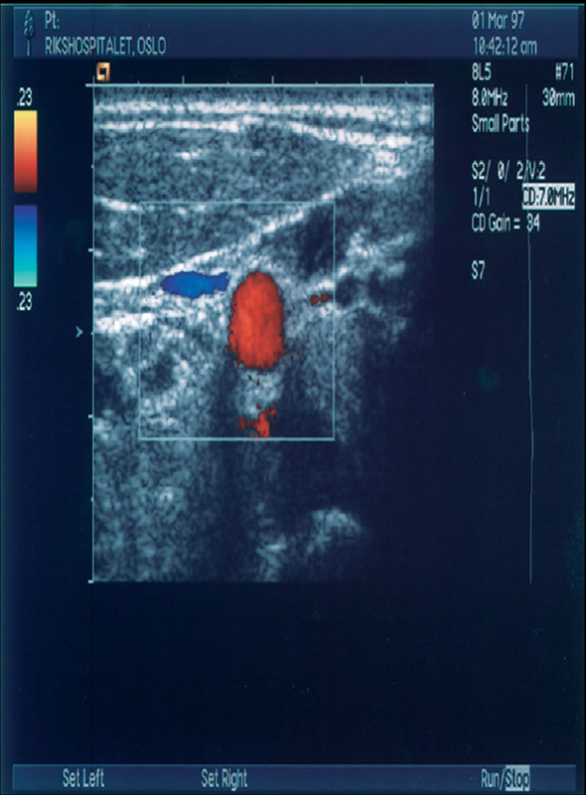
Doppler Imaging
Continuous wave (CW)
Use two crystals, one to send and one to receive
Doppler signals are obtained from all vessels in the field of view
Pulsed wave (PW)
The transducer sends and receives the signal
The returned signal is gated for the desired depth
Echo Correlation (CF)
Echo signature is in motion
Correlation maximization
Color Flow (CF)
Doppler equivalent of B-mode
Velocity is encoded as a color

Slide 25
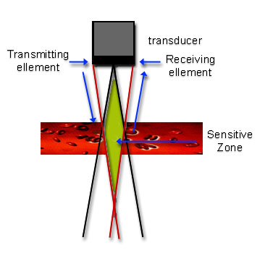
Ultrasound Imaging
Continuous wave (CW)
In a CW Doppler system there must be separate transmission and reception of ultrasound – transducer with two separate elements
The region from which Doppler signals are obtained is determined by the overlap of the transmit and receive ultrasound beams

Slide 26
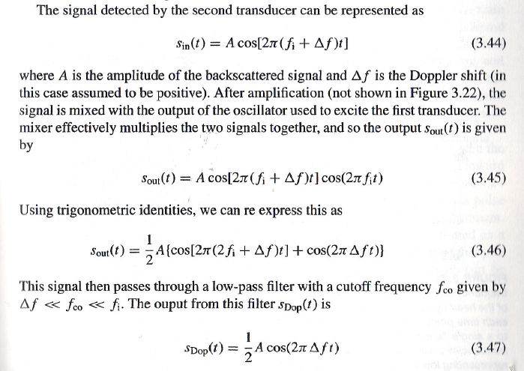
Doppler Signal Detection

Slide 27
Ultrasound Imaging
Pulsed wave (PW)
In a PW Doppler system it is possible to use the same transducer element for both transmit and receive
The region from which Doppler signals are obtained is determined by the depth of the gate and the length of the gate, which can both be controlled by the operator

Slide 28
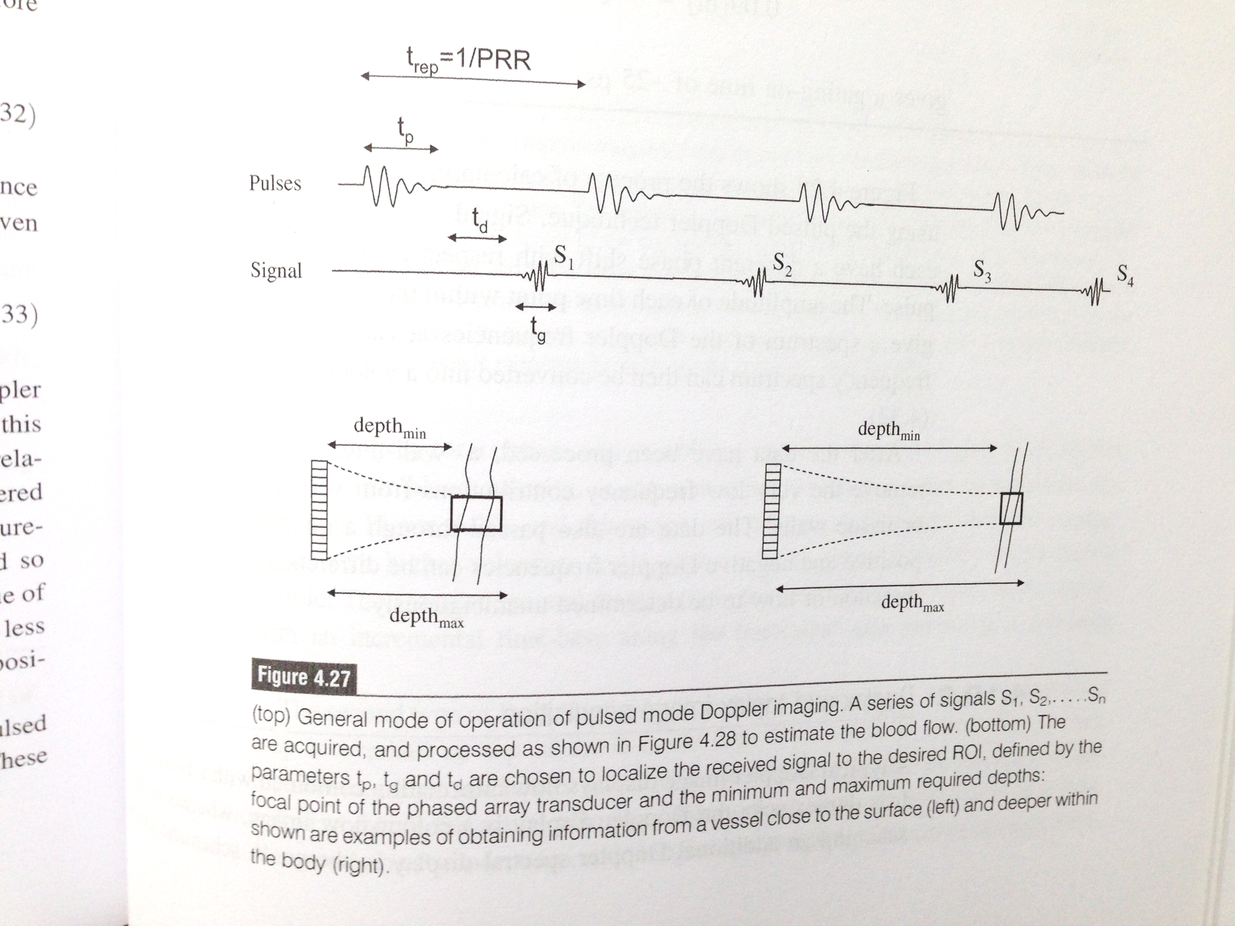
Pulsed Doppler Imaging

Slide 29
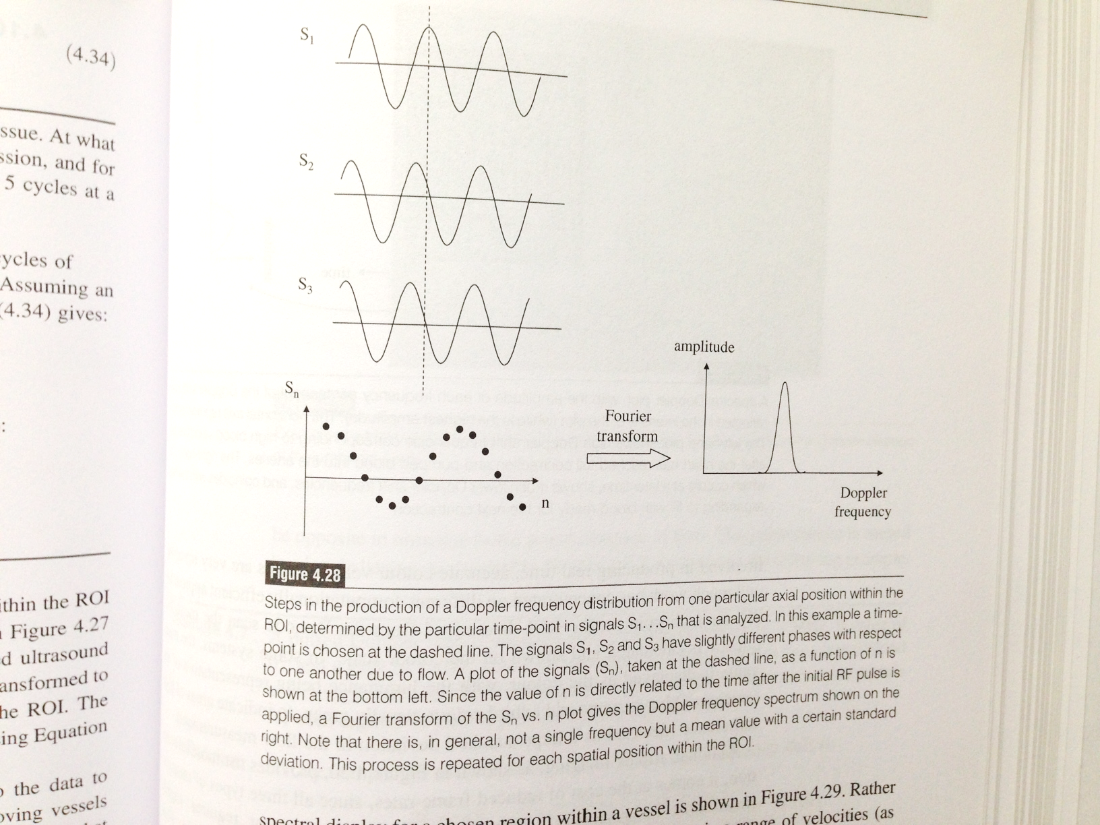

Slide 30
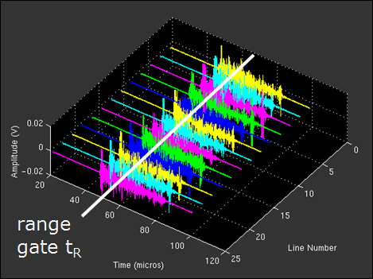
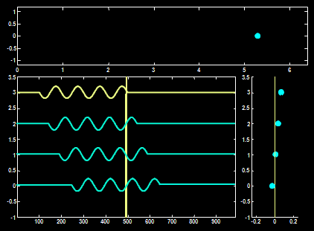
Pulsed Wave (PW) Doppler
does not make use of the Doppler principle!
Only 1 sample taken from the backscattered signal at a well-defined time delay after transmission (range gate)
M-mode acquisition

Slide 31
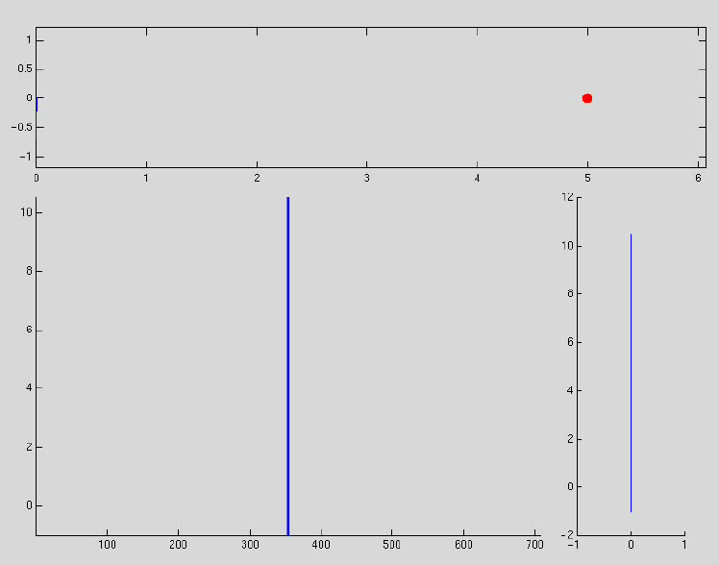
Pulsed Wave (PW) Doppler

Slide 32
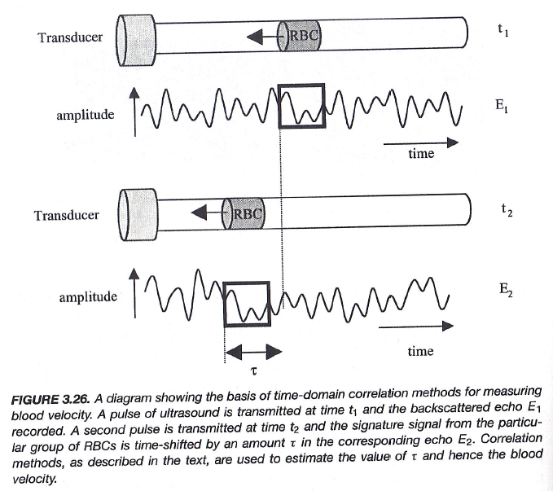
Correlation Method

Slide 33
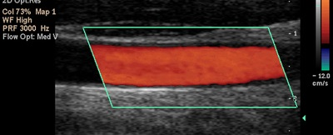
Color Doppler
US Doppler - Display
Doppler information is often combined with real-time B-mode
2D representation of the speed of the blood flow on a grey-scale image
Spectral Doppler: spectral display the brightness is related to the amplitude of the Doppler signal component at that particular frequency
Red – towards transducer
Blue – away from transducer
Green - Variance

Slide 34
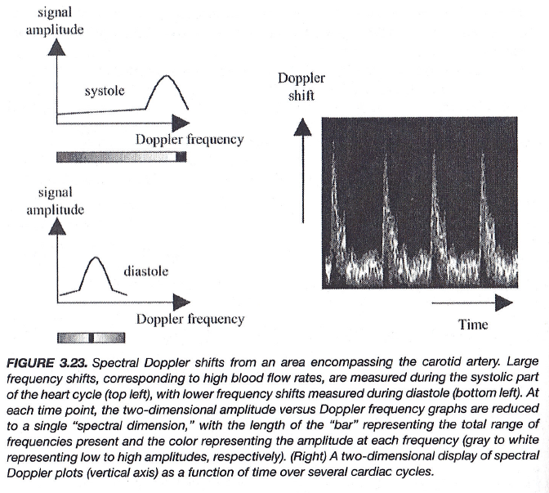
Spectral Doppler Imaging

Slide 35
Ultrasound Imaging Methods
Imaging Modes
A-, M-, B, C-Mode Scan
Huygens' Principle
Array-based Scanning & Beam Forming
Doppler Imaging
Doppler Frequency
Continuous Wave & Pulsed Mode
Echo Correlation & Color Doppler
Image Artifacts
New Things

Slide 36
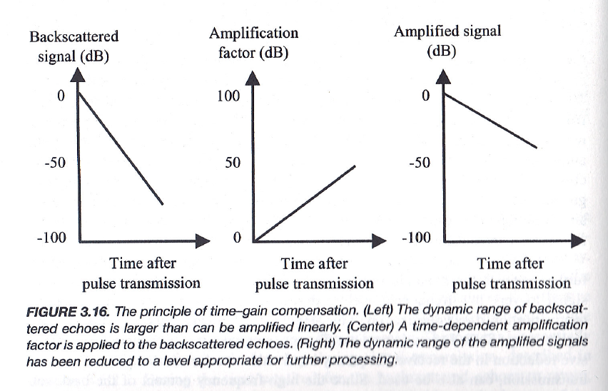
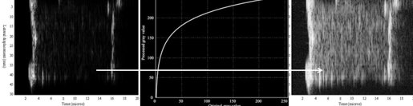
Time Gain Compensation

Slide 37
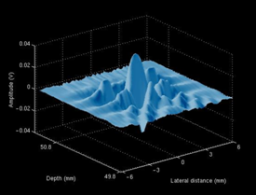
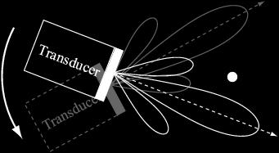
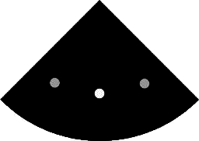
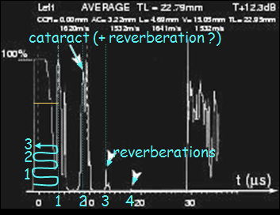
Artifacts
interference pattern contains side lobes
reverberations

Slide 38

US Artifacts

Slide 39
Ultrasound Imaging Methods
Imaging Modes
A-, M-, B, C-Mode Scan
Huygens' Principle
Array-based Scanning & Beam Forming
Doppler Imaging
Doppler Frequency
Continuous Wave & Pulsed Mode
Echo Correlation & Color Doppler
Image Artifacts
New Things

Slide 40





US & MRI Fusion
Intraoperative
Preoperative
Image Fusion
Tracked Real-time US
PreOp. MRI
Temporal resolution
Temporal resolution
Spatial resolution
Spatial resolution
Sensitivity/Specificity
Sensitivity/Specificity
Cost effective
Cost effective
Dr. Pingkun Yan’s work with NIH, Philips

Slide 41


US & MRI Fusion
Before 0.239
After 0.9946
Dr. Pingkun Yan’s work with NIH, Philips

Slide 42

Photoacoustic Tomography
Toumia et al. (2016); https://pubs.acs.org/doi/10.1021/acsami.6b04184

Slide 43

Photoacoustic Tomography

Slide 44



iUS in iPhone
v (RBC velocity) +
d (distance) +/-
s (cross-area) –
p (pressure) +

Slide 45

Homework: Review Green Chaps
Transfer: Familiarize/Repeat/Remember
Inspire: Understand/Create/Innovate
Closed: Book/PPT/Solutions/Answers
Open: Problems/Ideas/Tools/Motives

